Slide 1
Unified Product Catalog
Akanksha Pathak
Business Analyst Intern
Intern Roadshow
July 24th, 2019

Slide 2
Problem: Initial State
Commercial Aviation
Government & Military Aviation
Business Aviation
General Aviation

Slide 3
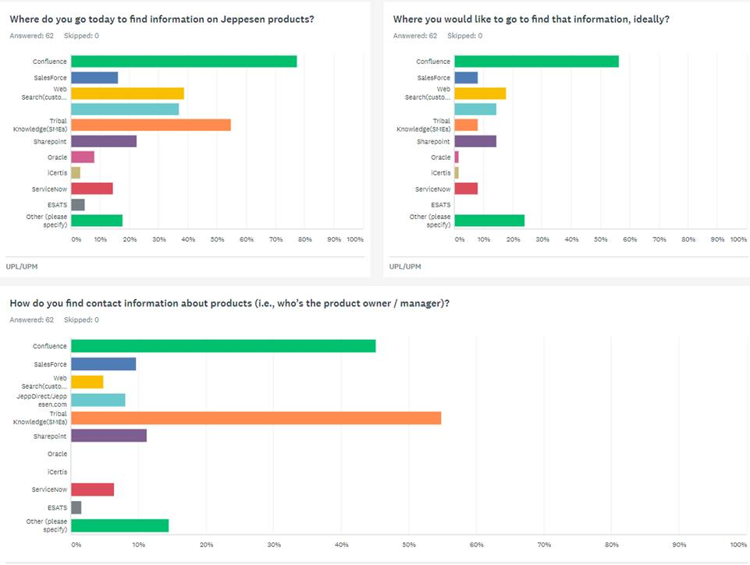
The Problem: Metrics
Themes:
Tribal knowledge is the #1 way to look for product contact info***
Wikis (e.g. Confluence) not only lead the way in how to find product info, they are the preferred method
Non-centralized ‘shared team repositories’ were mentioned repeatedly as how product info gets aggregated into operational processes
***15 minutes of talking to a product SME @$100/hr costs $50. Over 50% of DS&A’s workforce utilize this method. Engaging an SME 1x / mo. on a single product (1500*12) it costs DS&A ~$1m / year. We must solve this!

Slide 4


Slide 5
Solution: Future State
Commercial Aviation
Business Aviation
General Aviation
Government & Military Aviation

Slide 6



Slide 7
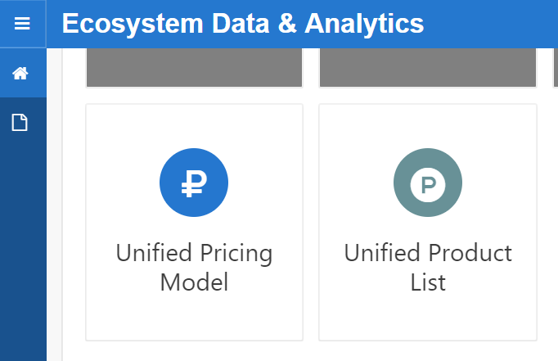
PRODUCT TAXONOMY
https://prezi.com/view/2CnJQICezxGhQE1P7K7j/
Requirements
User Stories, features, functional requirement, checklist
Model Population
https://prezi.com/view/b9KNQLGTlUWtf5aAOLPG/
UPC

Slide 8
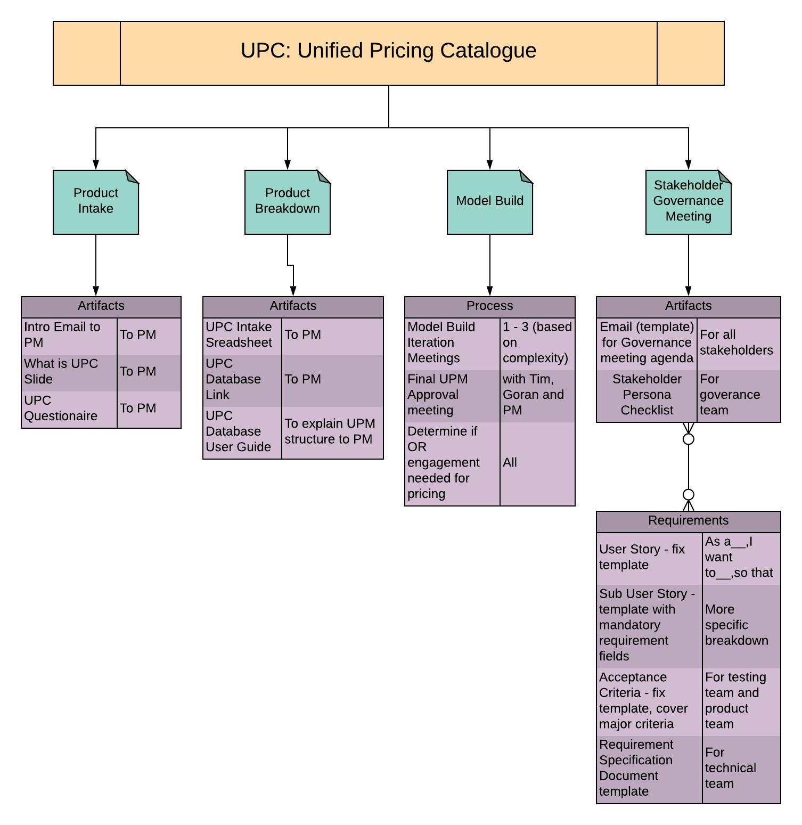
Streamlined UPC Process
Unified Product Catalog (UPC) includes:
Unified Product List (UPL)
Unified Pricing Model (UPM)
Captured and standardized the end-to-end process for UPC.
Created an interactive and intuitive design in SharePoint for new UPC stakeholders:
https://rp.sslvpn.boeing.com/sites/ppm/PMO/PE/Initiatives/frontoffice/Pages/,DanaInfo=daext.web.boeing.com,SSL+UPC-Framework.aspx

Slide 9



Thank You

